Slide 1



Session 15
Written Examination
and Program Conclusion

Slide 2

Learning Objectives
Complete written examination with passing grade
Provide comments and suggestions for improving course

Slide 3
Deterrence and DWI
What approximate percentage of fatal crashes involve drivers who have been drinking?
On any typical weekend night, approximately what percentage of cars are driven by persons who are DWI?

Slide 4
Deterrence and DWI
About how many times does the average DWI violator drive intoxicated before arrest?
An alcohol-related crash at night is more likely to result in death than is a non alcohol related crash. How many times more likely?

Slide 5
Detection Phases
What are the three phases of detection?
What is the definition of “DWI detection"?
What is the police officer's principal decision during Detection Phase One?
During Phase Two?
During Phase Three?

Slide 6
Laws
What does "Per Se" mean?
The "illegal per se" law makes it an offense to operate a motor vehicle while _________.
True or False: The implied consent law states suspected DWI drivers are deemed to have given their consent to submit to chemical testing.
True or False: A person cannot be convicted of DWI if BAC was below 0.05.

Slide 7
Alcohol Physiology
True or False: Alcohol is the most abused drug in the United States.
Name three of the more commonly known alcohols.

Slide 8
Field Sobriety Testing
What does "nystagmus" mean?
WAT is an example of a ______________ attention test
Name the eight distinct clues of WAT
Name the four distinct clues of OLS
Name the three distinct clues of HGN

Slide 9
Field Sobriety Testing
What is the critical angle for determining whether the third clue of HGN is present?
How many steps in each direction must the subject take in the WAT test?
How long must the subject stand on one foot in the OLS test?

Slide 10
Field Sobriety Testing
In the WAT test, a subject who steps off the line during the first 9 steps and once again during the second 9 steps and who uses arm(s) to balance twice during the second 9 steps has produced ____ distinct clue(s).
How reliable is each test using the San Diego study?

Slide 11
Post Test
“Closed book”
Passing score is 80%
Approximately 15-20 minutes to complete

Slide 12
Course Critique

Slide 13
Review of Post Test

Slide 14
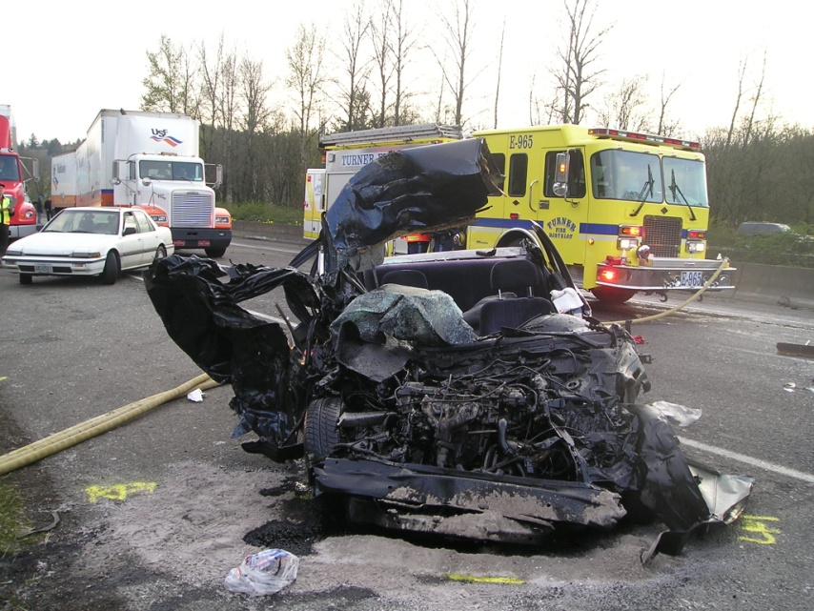
Ultimate Goal
Increase DWI Deterrence and Decrease Alcohol Related Crashes, Deaths and Injuries.

Slide 15
Job Performance Objectives
You will become better able to:
Recognize and interpret evidence of DWI violations
Administer and interpret validated psychophysical SFSTs
Describe DWI evidence clearly and convincingly

Slide 16
Questions?

